Slide 1
Connecting Women Veterans
Women Veterans Alliance
Melissa A. Washington
Navy Veteran
Women Veterans Engage
Women Veterans Giving
Women Veterans Magazine
Veteran.Events

Slide 2
Women Veterans Alliance
Started as a monthly meetup in Sacramento. Now serve women globally,
Directories:
Allies
Women Veteran Owned Businesses
Monuments
Authors
Resource
Speaker
Partnership Department of Labor ENPP
Merchandise Store
Stay up to date and get on our email list

Slide 3
Women Veterans Giving 501c3
To connect, empower, and cultivate growth of professional women veterans.
Melissa Washington Small Business Award- Quarterly
Professional Development
Partnership with Thrive Causemetics
Fiscal Agent

Slide 4
Veteran Events
Provide event services
Online Calendar
Women Veterans Conference Page
Speaker Directory

Slide 5
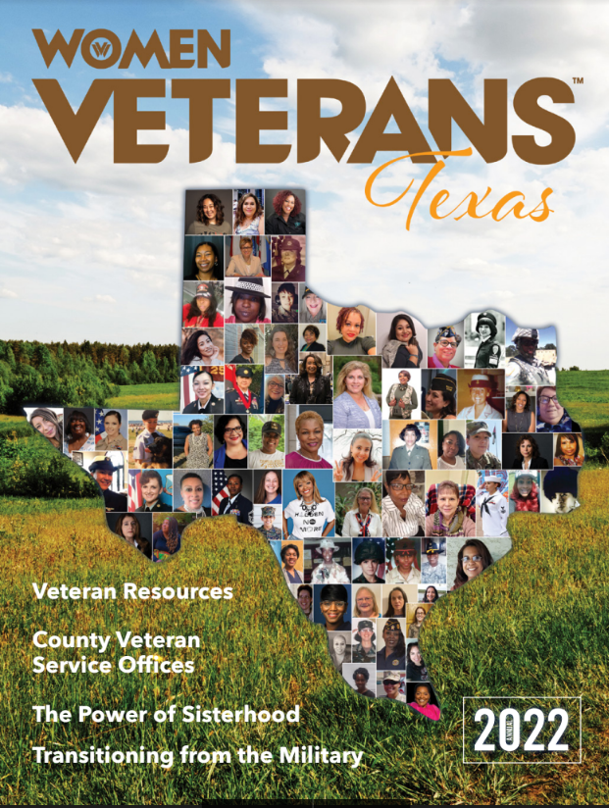
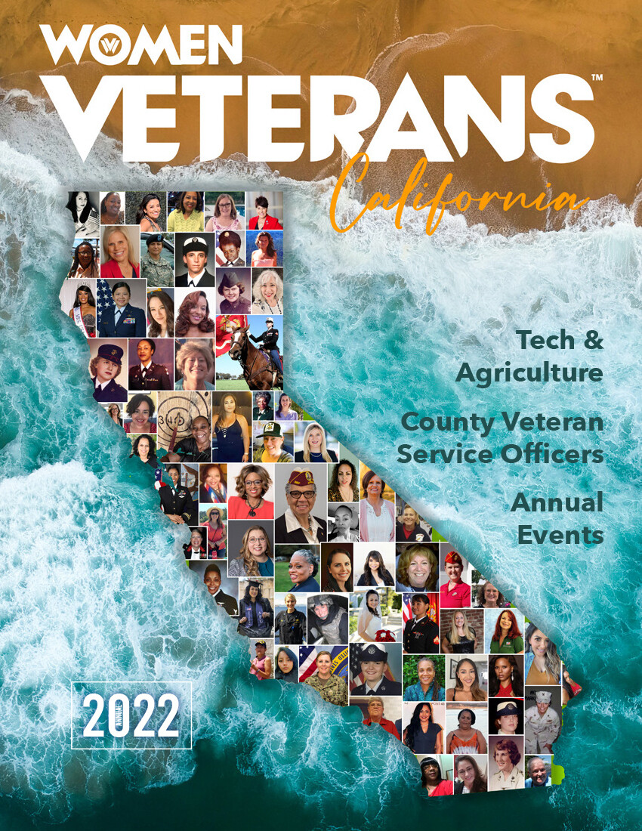
Magazine

Slide 6
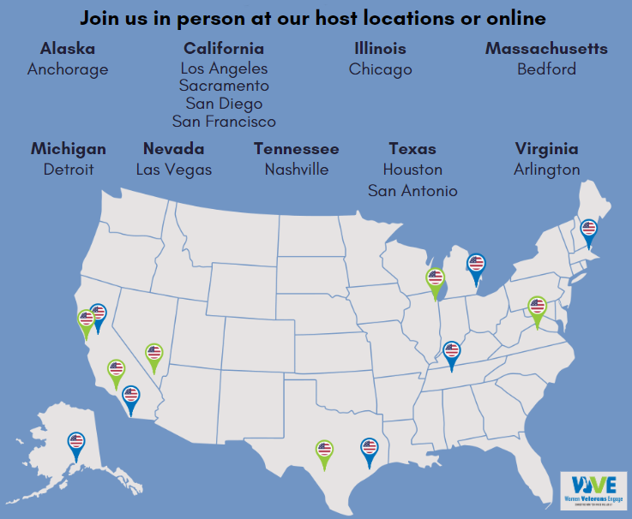
Engage

Slide 7
Thank You
Melissa A. Washington
530.830.1915
melissa@womenveteransallaince.com
Women Veterans Alliance

