Slide 1
Office of Women’s Health
Communications Updates
April 2022

Slide 2
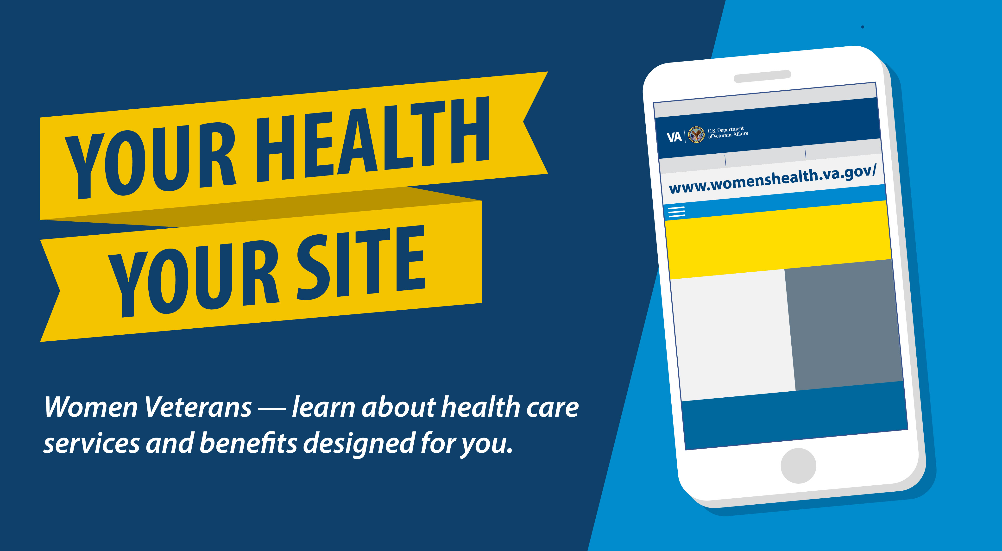
WomensHealth.VA.gov website revamped to better serve women Veterans

Slide 3
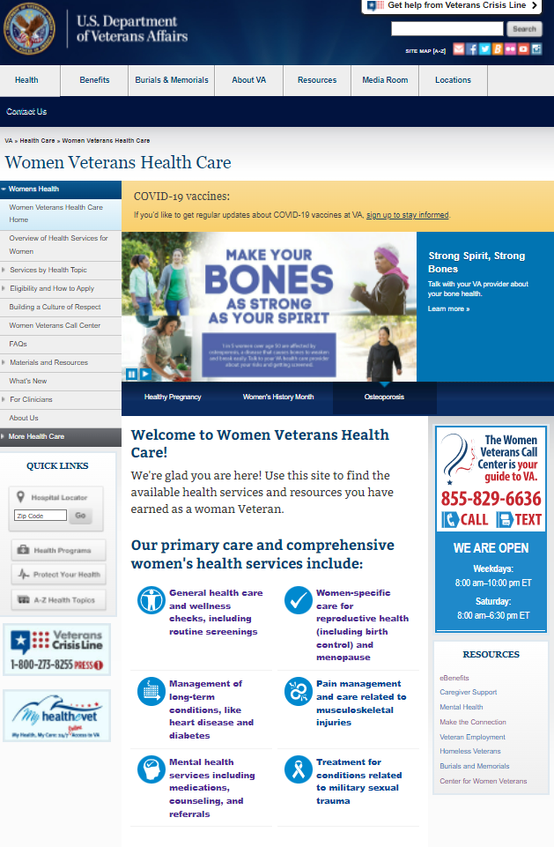
Women’s Health Care Website
Every page updated to highlight the information women Veterans need
Find health care services by clicking on the “Services by Health Topic” in the menu
Content revised to be more plain language and inclusive
https://www.womenshealth.va.gov/

Slide 4
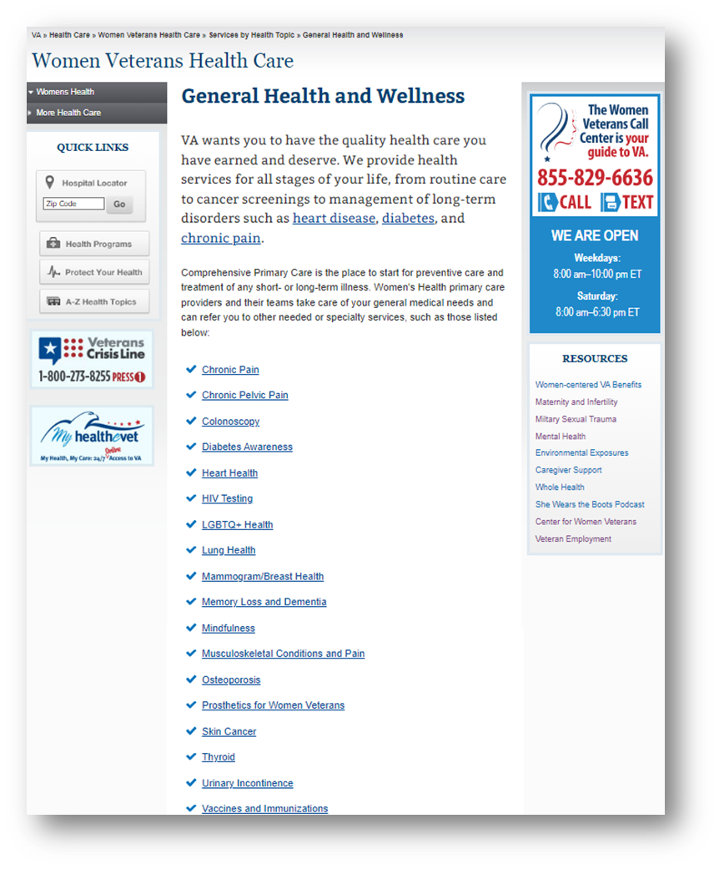
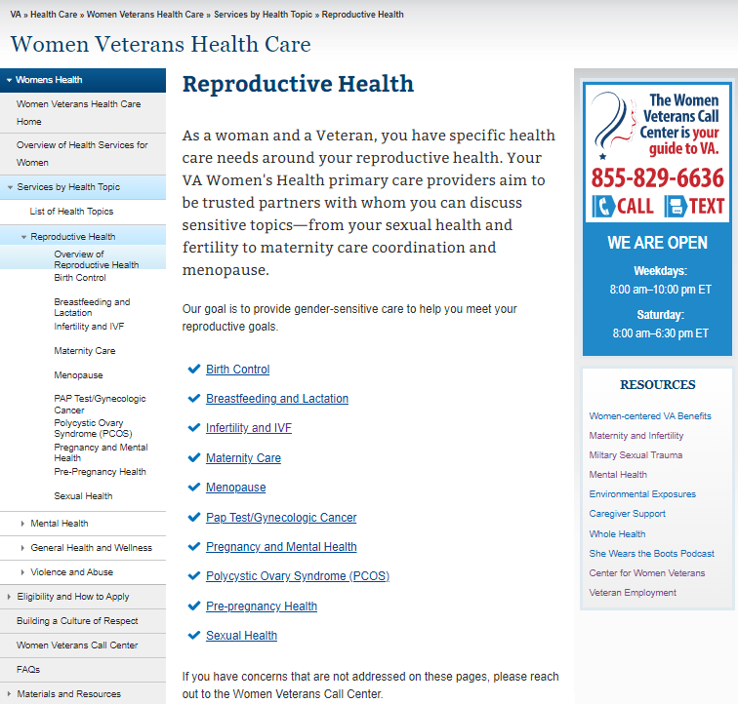
General Health and Reproductive Health
https://www.womenshealth.va.gov/

Slide 5
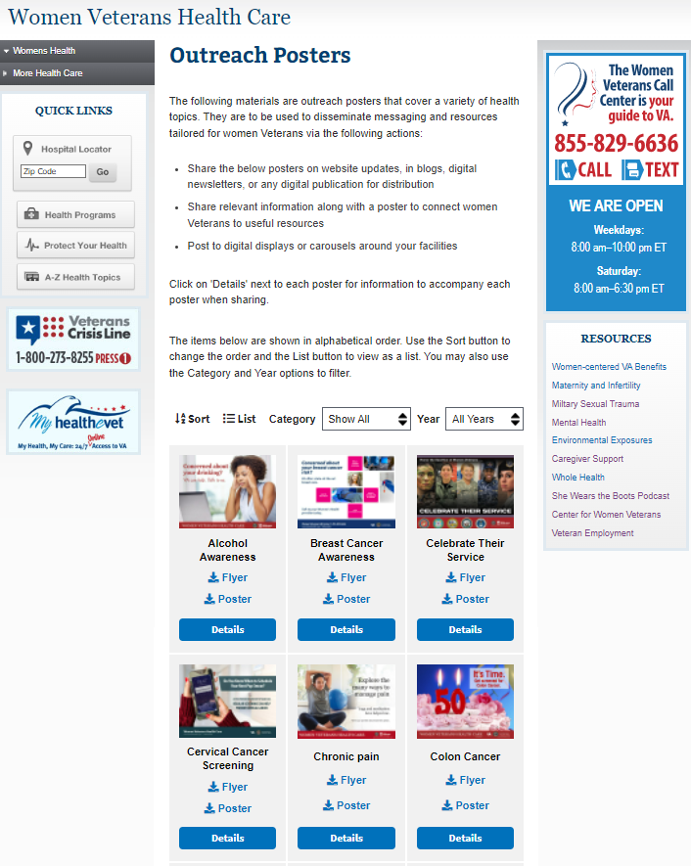
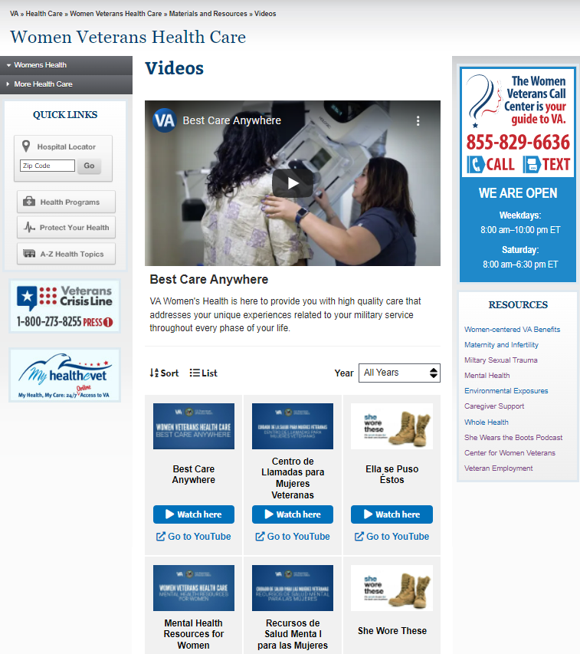
Outreach videos
https://www.womenshealth.va.gov/

Slide 6




What we ask of you…
Look at the site &
let us know if you have suggestions
Update any links to the site
(all pages have new URL)
Help us spread the word!
https://blogs.va.gov/VAntage/102039/womenshealth-va-gov-website-revamped/#comment-203898

Slide 7
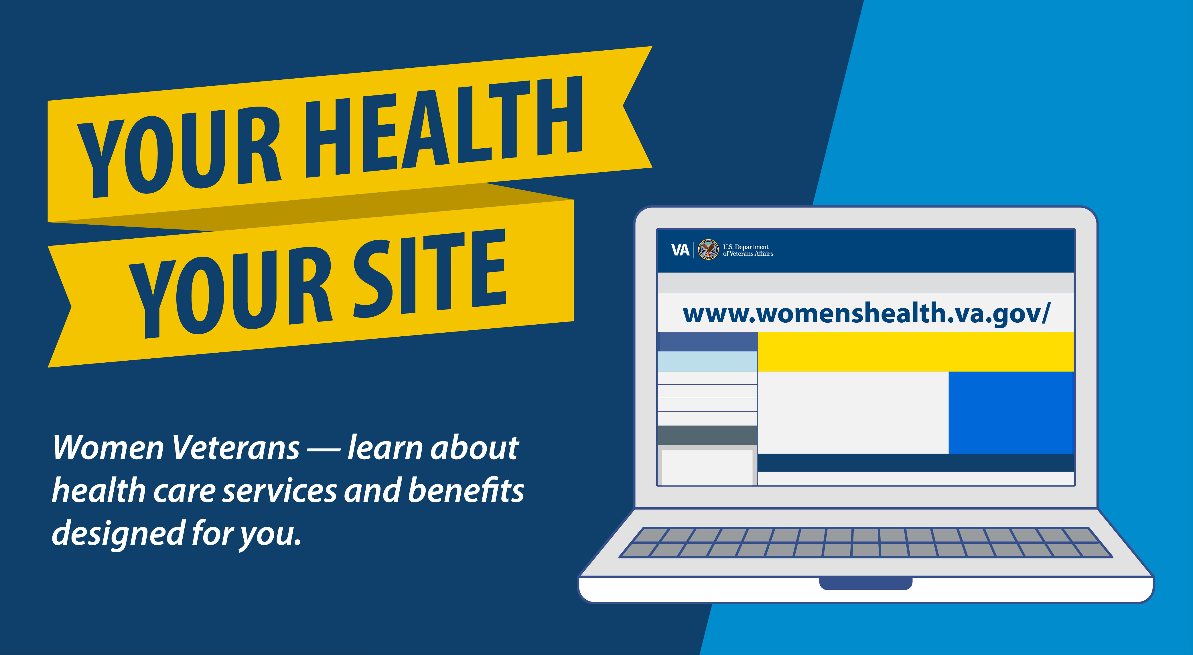
Contact
Women’s Health Creative Services team:
vacovhawhcs@va.gov

