Slide 1
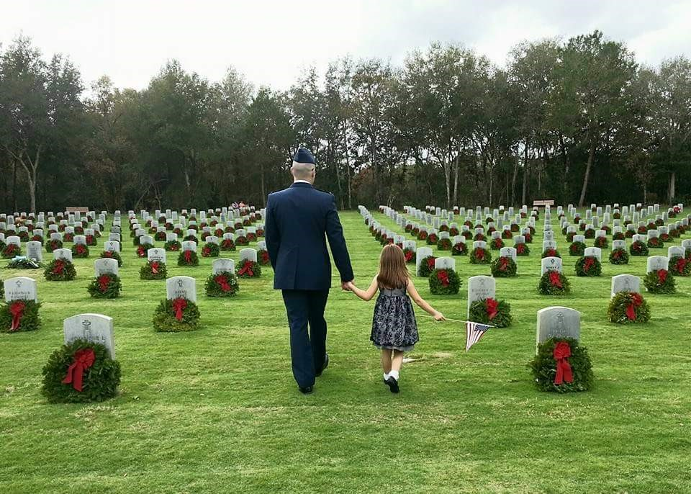
Wreaths across America
Wreaths Across America

Slide 2


Wreaths Across America LTTL

Slide 3
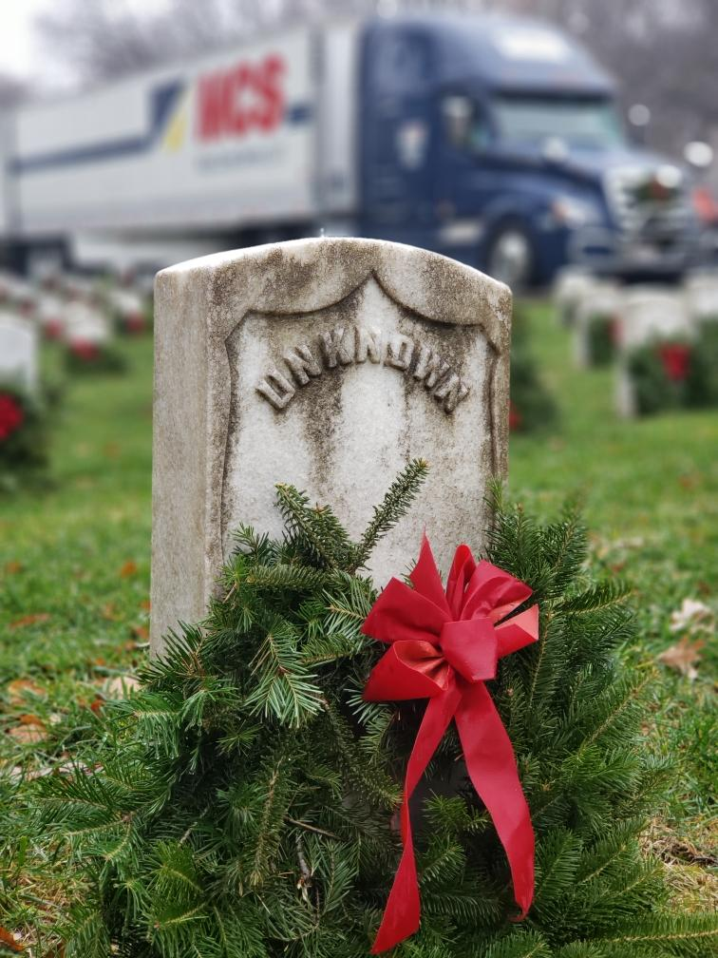
What is
Wreaths Across America?
What is
Wreaths Across America?
National nonprofit organization
Founded in 2007
Continues to expand
Annual wreath-laying ceremony at Arlington National Cemetery begun by Maine businessman Morrill Worcester in 1992.

Slide 4
Remember the Fallen…
Remember the Fallen…
How We Remember
WAA’s annual pilgrimage from Columbia Falls, Maine, to Arlington National Cemetery in Virginia
The Remembrance Tree Program provides a living memorial to loved ones lost
The HART Ceremony is conducted each year to honor veterans of our nation’s allies
WAA hosts statehouse ceremonies in nearly 50 states.

Slide 5
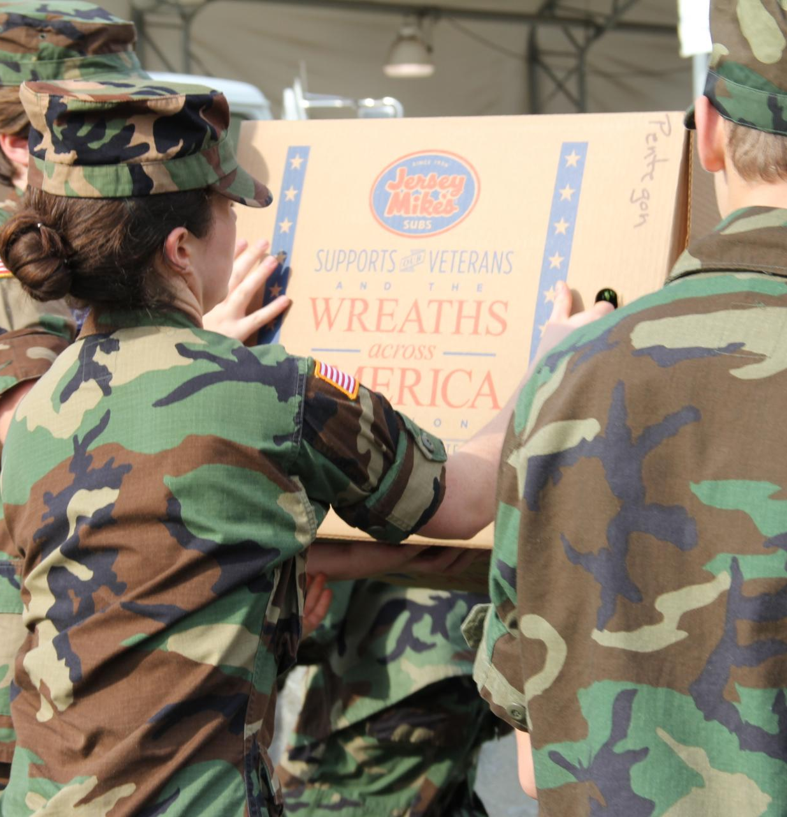
How We Honor
Honor those that Serve and their families…
WAA conducts several programs to honor our veterans, including our popular Thanks-A-Million campaign, which distributes free “I Owe You” cards to people all over the country
The organization participates in veterans’ events throughout the year through Veterans Day, Memorial Day, WAA Radio, in our monthly newsletters, in press coverage and on the website and social media
Through WAA’s group sponsorship program, WAA has helped other nonprofits such as Civil Air Patrol, Scouts, 4-H Clubs, local VFWs and American Legions raise funds for their own community needs
The WAA Museum located at the National HQs in Columbia Falls, ME, and showcases thousands of items that have been donated to WAA over the decades
Wreaths Across America has a veteran liaison on staff to work with local veterans’ organizations in Maine

Slide 6
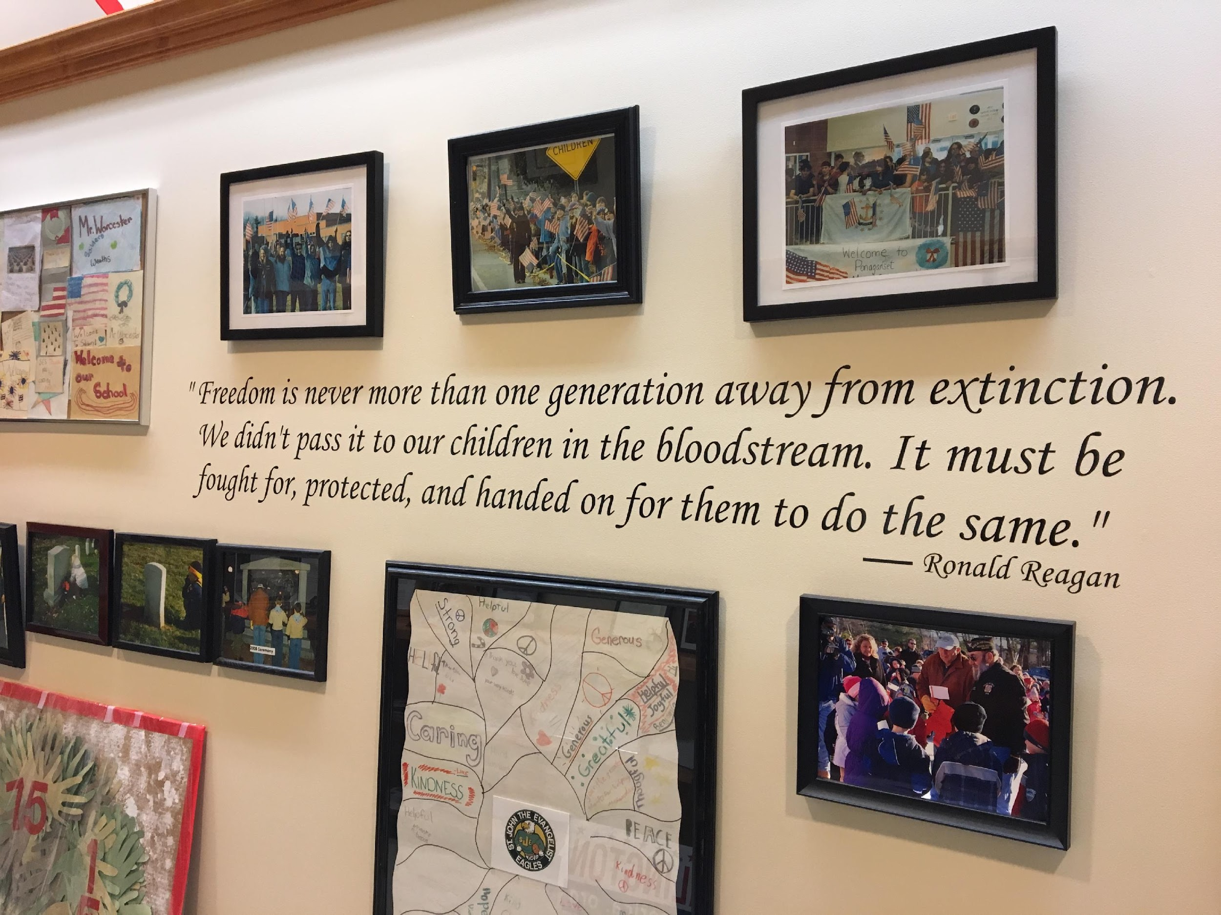
Teach the next generation about the value of freedom…
Teach the next generation about the value of freedom…
How We Teach
WAA is committed to teaching younger generations about the value of their freedoms and the importance of honoring those who sacrificed so much to protect those freedoms. We offer learning tools, interactive-media projects and opportunities for schools, 4-H clubs, Scouts and other youth groups to participate in our efforts.
The Mobile Education Exhibit is a traveling classroom on wheels designed to inspire and educate all about the mission and those who lives have been impacted by it. The goal of the Wreaths Across America Education Exhibit is to bring local communities and our military together with education, stories and interactive connections.

Slide 7
Growth by Region
Growth by Region
4,000+ local sponsorship groups
in all 50 states
3,100+ participating locations
in addition to Arlington National Cemetery

Slide 8
Chart
First wreaths (5,000) donated by Morrill Worcester and Worcester Wreath Co.
1992
Iconic photo of wreaths in snow became a viral sensation
2005
With the help of the CAP and other civic organizations, simultaneous wreath-laying ceremonies were held at over 150 locations around the country.
2006
Wreaths Across America formed as a 501(c)(3) nonprofit organization
2007
Millionth wreath placed at Arlington National Cemetery
2012
For the first time, every headstone at Arlington National Cemetery received a wreath.
2014
25th year that veterans’ wreaths were placed at Arlington National Cemetery.
2016
Mission advances overseas with the first placement of 9,387 veterans’ wreaths at Normandy-American Cemetery in France.
2018
Placed 2.2 million veterans’ wreaths at 2,158 participating locations across the country
2019

Slide 9
Sponsorship Groups
Sponsorship Groups
Options
There are THREE types of sponsorship groups that you can sign up for to raise money for a specific cemetery location(s) or to give to WAA to allocate wreaths where most needed.
The sponsorship group will benefit directly from being a $5-Back Group
1
$5-Back Group
2
3-for-2 Group
3
No Plan Group

Slide 10
$5-Back Group
$5-Back Group
Designed for other nonprofits and civic groups to benefit from.
For every $15 wreath sponsorship sold, your registered group will receive $5 back for your own program.
All sponsorships are sent to WAA HQ in Maine for processing
At the end of each month WAA sends a pay back check
$15M
Over the last 12 years WAA has given back to these groups

Slide 11

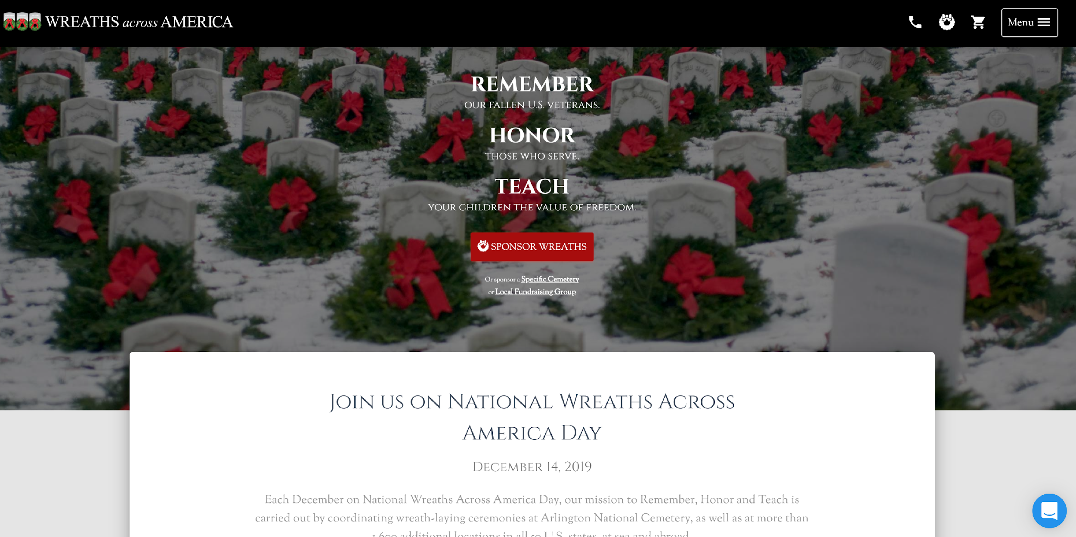

Getting Started
Getting Started
1
Select a participating cemetery your employees will raise funds for.
2
Register your group online.
3
Create your custom Sponsorship Page.
4
Promote your Sponsorship Page.
5
Host fundraising events in your community!
6
Fundraising can be done year-round!
Notes:
Getting Started (incorporate screen shots of steps on site throughout)
Select a participating cemetery your squadron will raise funds for. It could be Arlington National Cemetery, or a cemetery in your state or local community (we will have approx. 1,700 participating locations this year).
You can find if a cemetery is participating by visiting www.wreathsacrossamerica.org and clicking “Search Locations/Groups” from the Menu.
Register your group online. Follow the steps found
at www.wreathsacrossamerica.org/fundraising. You will be assigned a group ID number, it will be important to include this on all donations remitted to us to ensure your group is credited.
Create your custom Fundraising Page. Once registered, a fundraising page will be created for you which you can then sign in to customize and manage for your group through www.wreathsacrossamerica.org.
Select “Sign In” at the bottom of the Menu and click “Manage Locations/Group Pages.” There you will be instructed to create a log in and password and can then begin following instructions to customize your page.
Promote your fundraising web page. Once complete you can share your page with friends, family and contacts to start raising funds. All sponsorships made through this site will be credited to your group.
Host fundraising events in your community! Build awareness for your group and Wreaths Across America through various events, such as having a table display at community gatherings, hosting a bake sale or spaghetti dinner, make up flyers with your squadron’s information and share with local veteran organizations. Share the mission within your community!
Fundraising can be done year-round! For every $15 wreath sponsorship sold, $5 comes back to your squadron.

Slide 12
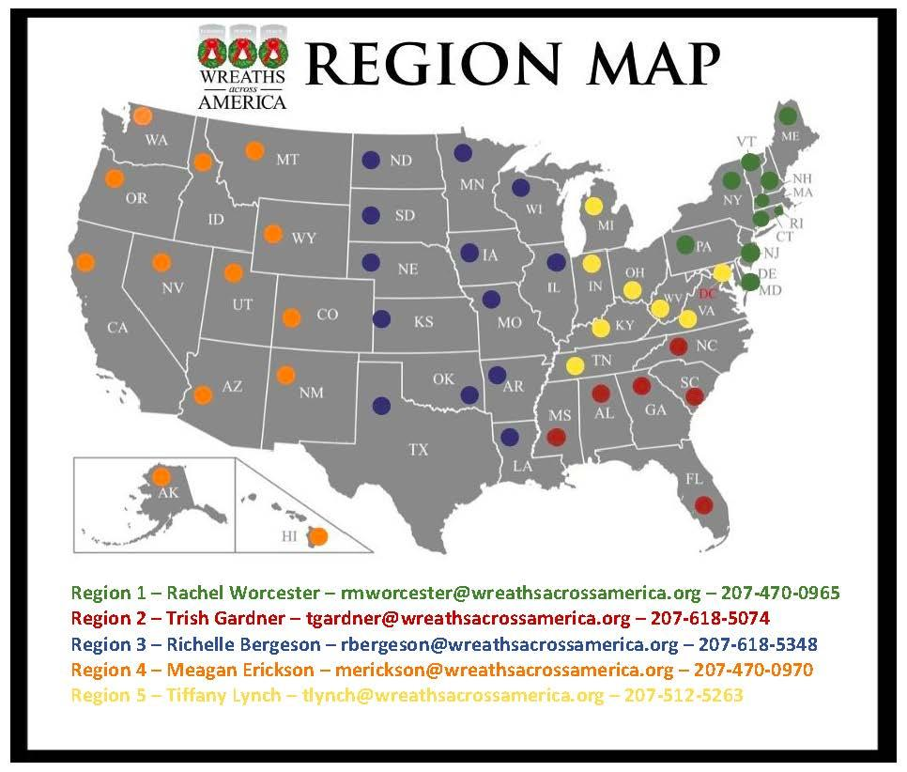
Resources
Resources
WAA has Regional Location and Sponsorship Group Liaisons available to aid volunteers throughout the country as need.
WAA also offers tools and templates to help promote group involvement and informational materials for Groups to use when speaking with the public about WAA.

Slide 13

2021 Notable Events
2021 Notable Events
SUNDAY, DECEMBER 12, 2021
  Convoy departs from Harrington, Maine
FRIDAY, DECEMBER 17, 2021
  D.C. Welcome Reception & Dinner
SATURDAY, DECEMBER 18, 2021
  National Wreaths Across America Day

Slide 14
Contact Information
Contact Information
Director of Military and Veteran Outreach
Joe Reagan
jreagan@wreathsacrossamerica.org
Address
Maine office (Headquarters)
4 Point St, Columbia Falls, ME 04623
Phone & Email
HQ Phone : (877) 385-9504
Email: info@wreathsacrossamerica.org
Social Media
facebook.com/wreathsacrossamerica
twitter.com/wreathsacrossamerica
youtube.com/wreathsacrossamerica

Slide 15
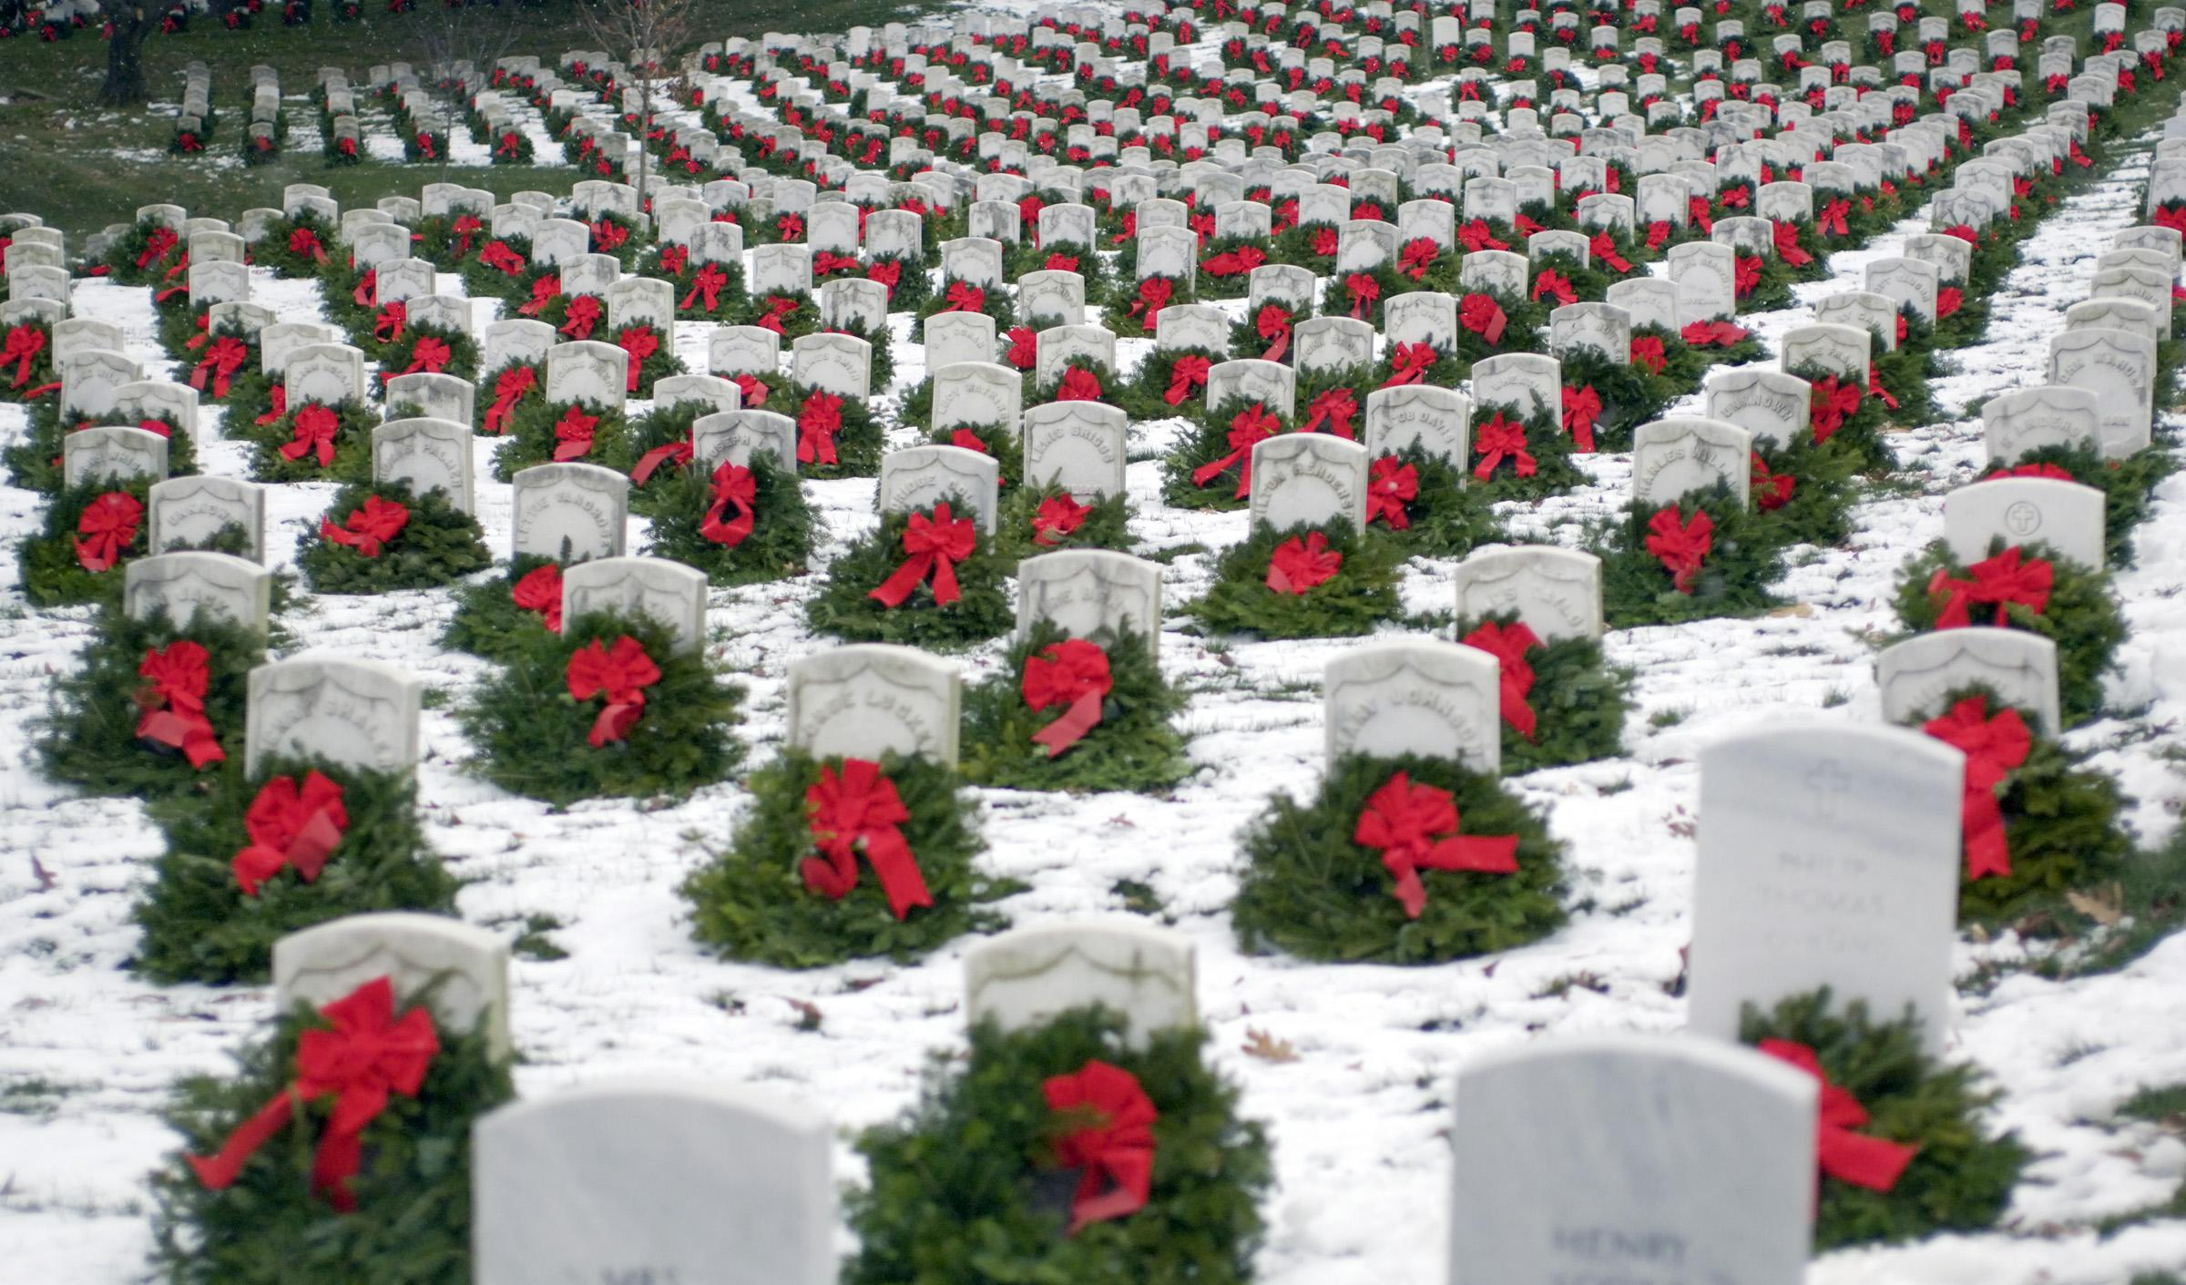

Thanks for Your Time
Thanks for Your Time

