Slide 1


VETERANS HEALTH ADMINISTRATION
Meeting the Needs of Aging Veterans: VHA Geriatrics and Extended Care and Geriatric Mental Health Programs
Scotte R. Hartronft, MD, MBA, FACHE Executive Director
VHA Office of Geriatrics and Extended Care
Michele J. Karel, PhD, ABPP
National Mental Health Director, Geriatric Mental Health
VHA Office of Mental Health and Suicide Prevention
April 7, 2021
Center for Women Veterans partnership meeting

Slide 2
Numbers of Female and Male Veterans, and VHA Users, 2019
4,500,000
4,500,000
4,000,000
4,000,000
3,500,000
3,500,000
3,000,000
3,000,000
2,500,000
2,500,000
2,000,000
2,000,000
1,500,000
1,500,000
1,000,000
1,000,000
500,000
500,000
0
0
17 to 25 to
24 34
35 to 45 to 55 to 65 to 75 to 85 or
44 54 64 74 84 older
17 to 25 to 35 to 45 to 55 to 65 to 75 to 85 or
24 34 44 54 64 74 84 older
Female Veterans
Female VHA users
Male Veterans
Male VHA users

Slide 3
Percentage of Female and Male Veterans by Age Group, 2019
30%
% aged 65 and over:
Female Americans: 22.6%
Female Veterans: 19.0% Female VHA users: 16.2%
25%
Male Americans: Male Veterans: Male VHA users:
19.1%
49.1%
57.2%
20%
15%
10%
5%
0%
17 to 24
25 to 34
35 to 44
45 to 54
Female
55 to 64
Male
65 to 74
75 to 84
85 or older

Slide 4
Percentage of Veterans who are VHA Users by Age Group, 2019
45%
40%
35%
30%
25%
20%
15%
10%
5%
0%
17 to 24
25 to 34
35 to 44
45 to 54
55 to 64
65 to 74
75 to 84
85 or older
Female
Male

Slide 5
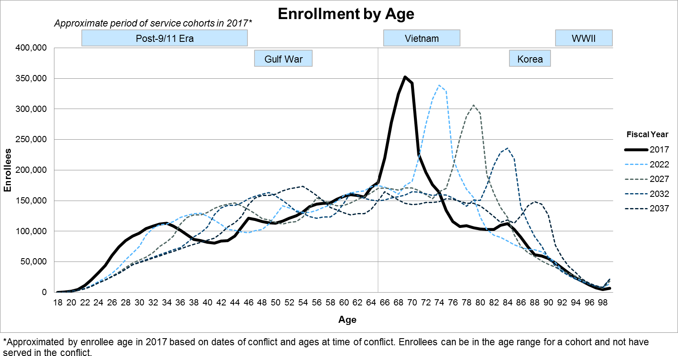
Veterans Health Administration Enrollees
The large cohort of Vietnam-era enrollees have just reached Medicare eligibility
The number of 75- year-old enrollees will more than double over the next 5 years
Services have unique utilization patterns by age; therefore the aging of VA’s population profile affects the utilization projections for each service differently
2018 VA Enrollee Health Care Projection Model
Draft - Pre-Decisional Deliberative Document Internal VA Use Only
5

Slide 6
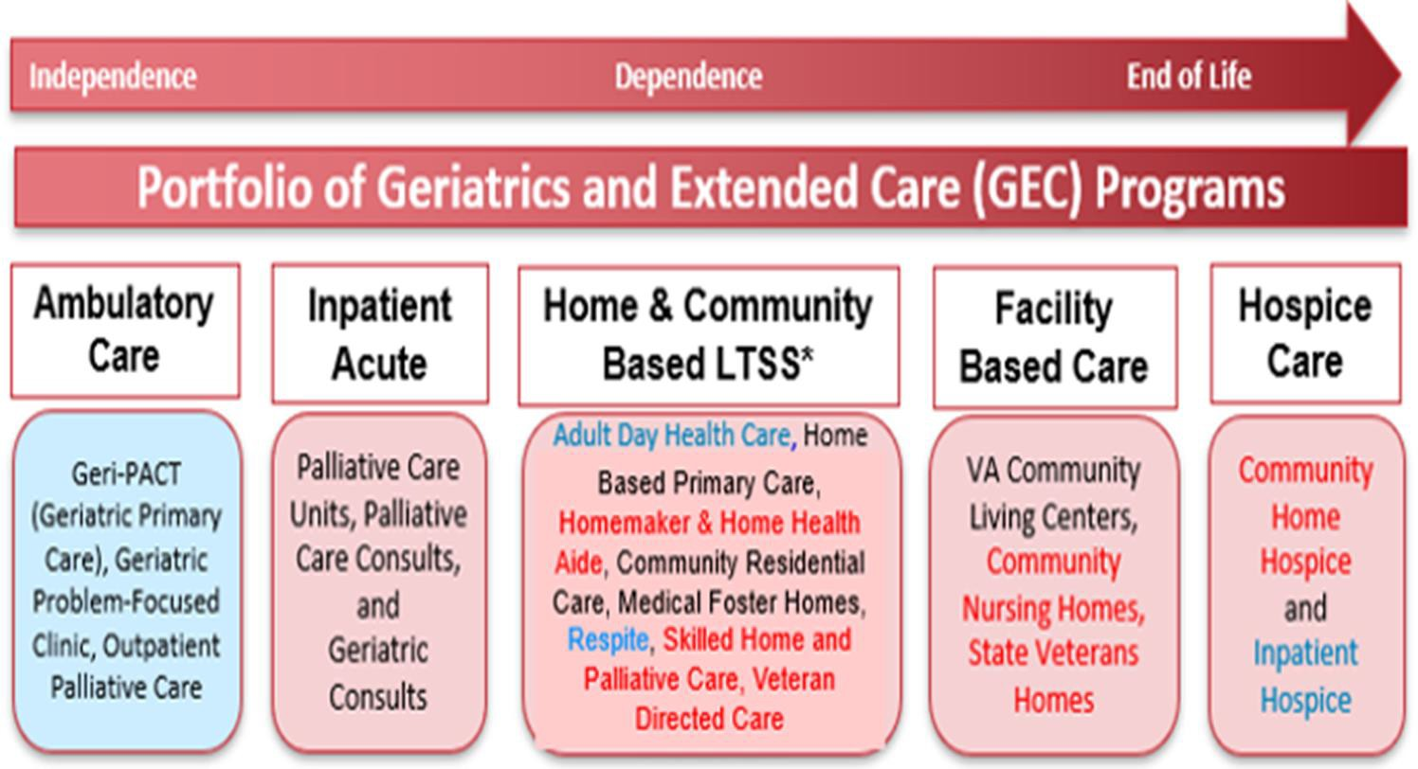
VHA Geriatrics and Extended Care – Continuum of Care for ALL Ages

Slide 7
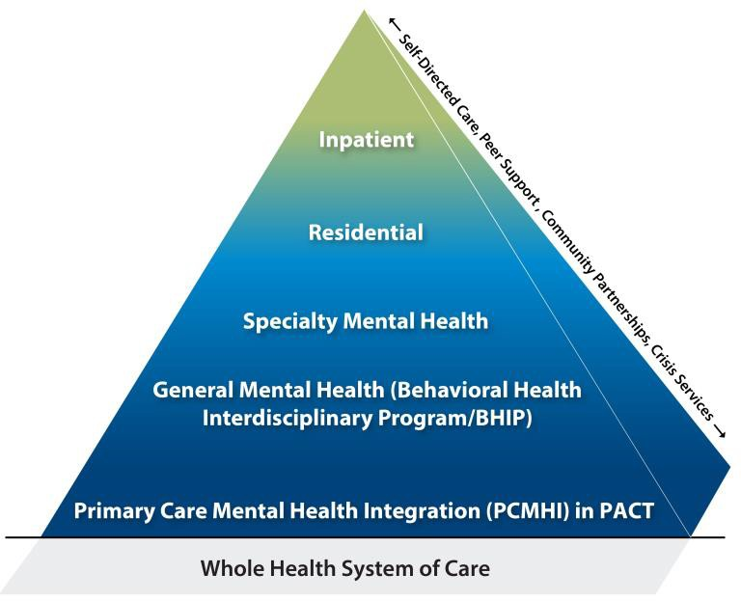
Mental Health Services and Geriatric Mental Health
Veterans of all generations, women and men, receive VHA mental health (MH) services across the continuum of care
Geriatric Mental Health: A section of the Office of Mental Health and Suicide Prevention (OMHSP)
  Close collaboration with Office of GEC
Activities include
  Support the integration of MH services in GEC programs
    Home Based Primary Care, Community Living Centers, GeriPACT, Palliative Care
    STAR-VA program: Help CLC teams care for residents with
dementia and distressed behaviors
  Collaborate on initiatives, e.g., dementia care, Veteran Community Partnerships, evaluation activities
  Identify and promote innovative and promising models of
specialized geriatric MH services in VHA
  Facilitate interprofessional geriatric MH education and training opportunities
  Develop VA and non-VA partnerships to help meet mental health needs of aging Veterans
And: VHA MH services are provided across GEC, rehabilitation, medical, and homeless programs
Multiple resources to promote gender-sensitive
women’s mental health services

Slide 8
Select Resources
Older Veteran Behavioral Health Resource Inventory (va.gov)
  2021 update pending
Geriatrics and Extended Care Home (va.gov)
Mental Health (va.gov)
  Women Veterans
Suicide Prevention - Veteran Resources (va.gov) and Veterans Crisis Line
  Preventing Suicide among Older Veterans brochure
PTSD: National Center for PTSD Home (va.gov)
  Understanding PTSD and Aging (va.gov) and Comprender el TEPT y el envejecimiento (va.gov)

Slide 9

Questions and Comments
Priorities and recommendations for meeting needs of aging women Veterans in the years ahead?

