Slide 1
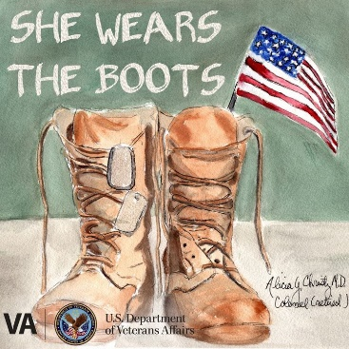
She Wears the Boots a Podcast for Women Veterans
VHA Office of Women’s Health
VETERANS HEALTH ADMINISTRATION
11/3/21
Center for Women Veterans
Partner’s Meeting
Notes:
Thank you. I’m really appreciative to be here today. Thanks to you all for all that you do for women who served. As mentioned I work for the VHA Office of Women’s Health and I run a number of different projects. I’m pretty lucky to be working on this one, its been a lot of fun.

Slide 2
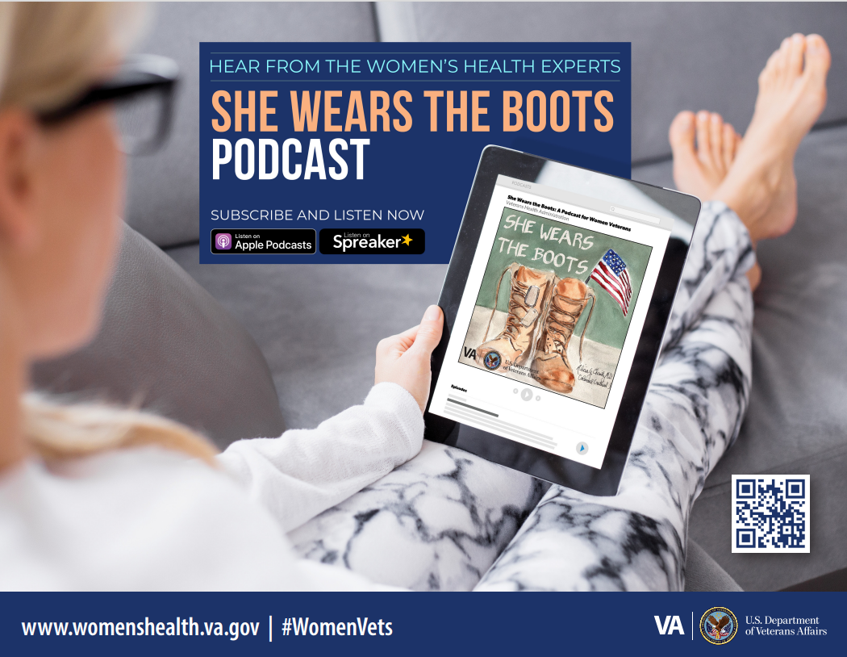
She wears the boots podcast
Notes:
I’ll start by giving you some background about how we got started with the podcast. Shortly after the pandemic started in spring of 2020,
our VHA Office of Women’s Health Culture Change committee noted that there was a need to change the way we were conducting outreach. Patients were coming in for face to face visits less frequently in the early days of the pandemic since more visits were being conducted virtually. One of our committee members had some experience with podcasting. So we considered whether we could develop a podcast for women Veterans as a way to continue to raise awareness about what the VA has to offer for women Veterans.
This slide represents one of the promotional materials we use for the podcast and you can get to the podcast through the QR code in the corner. (Plug)
Our podcast host is Wendy Fahlgren, who works at the VA in Iowa City and throughout that region as the Women’s Health Lead, while I do the behind the scenes work on brainstorming topics, potential guests, and moving things through the process.

Slide 3
Why a Podcast from Women’s Health?
OUTREACH to women Veterans
Highlight PROGRAMS that support the well-being of women
Highlight HEALTH CONCERNS specific to women
New EMPLOYEE education
Notes:
So, what are we trying to accomplish with a podcast for Veterans?
First, it’s a new way for us to outreach to women Veterans. We focus each episode on topics that are important to women who served and hope that women who do not use the VA yet for their healthcare might learn a bit more about what the VA can do to support all of their needs. We also expect women who ARE getting their care at the VA might have an interest in hearing more about what the VA does to support them in their healthcare needs.
So, we highlight programs and resources that support the well-being of women. We also highlight some health concerns that might be more specific to women or might need special consideration for women. I’ll say a bit more about this on the next few slides.
We are also finding that some clinicians who are new to the VA are using these episodes as a way to learn more about what the VA is doing to support women who come to us to get their healthcare needs met.

Slide 4
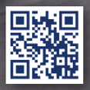
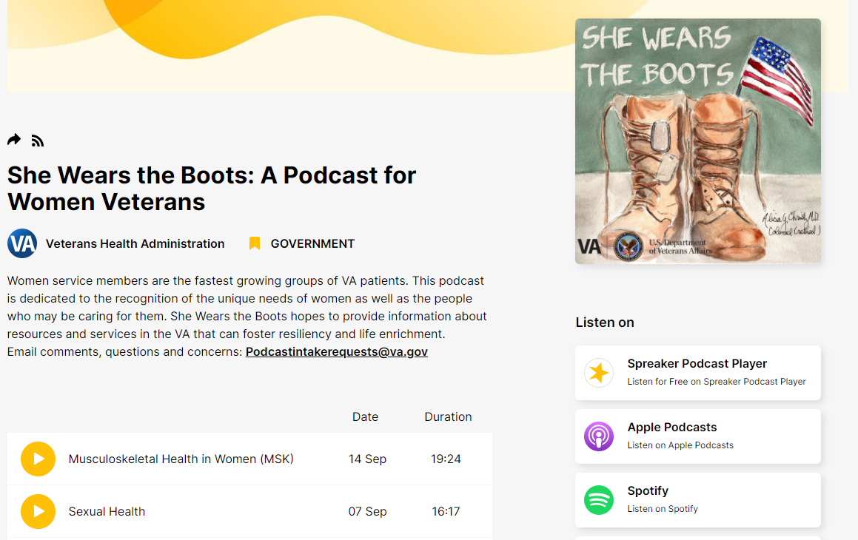
Hosted on Spreaker
Episodes listed here
Notes:
The VA hosts a number of different podcasts and uses Spreaker as the platform, which is where you can find our podcast as well. When you get to this site, you can see a list of all the podcasts recorded thus far, listed by release date. See the arrow on the left. When you click into each episode, you will see a brief description about the guest and content for that episode.
Our goal is to aim to record about 1 episode a month although we tend to just release them once they have been recorded, edited, and reviewed.
You can listen to these on spreaker but if like to listen to podcasts on another platform, there are a number of different ones to choose from where you can download new episodes or just listen. If you are looking at this on a computer, you can find the list at the arrow at the right that you see on the screen I am showing. If you are looking at it from a cell phone, you need to swipe to the right where shows the icon for the “spreaker podcast player.”

Slide 5
Focus of Episodes
Program Overviews
Myth Busters
Women’s Health VA Overview
What Matters to You? Whole Health Overview
Flu Shot Facts and Myths
Heart Health Facts and Myths
Sexual Health
Musculoskeletal Health in Women
Healthcare Topics
Notes:
Here is a breakdown of how we approach the planning of our episodes. We aim for each episode to be about 15-20 minutes long so that it is easy to listen to in one sitting, perhaps while waiting for an appointment in the clinic at the VA, in a drive to work, or during a walk.
So let me tell you about the focus of the episodes which tend to fall within three different areas.
Women’s Health in the VA Overview: Dr. Patty Hayes, Chief Officer for Women’s Health at VA Central Office, discusses past, present, and future state of Women’s Health in the VA.
What Matters to you? Whole Health Overview: Dr. Cynthia Gantt, Deputy Director, Office of Patient Centered Care and Cultural Transformation at VA Central Office, provides an overview of Whole Health in the VA and how women Veterans can personalize their care by engaging in the Whole Health approach.
Flu Shots: Dr. Chelsea Cosby reviews facts and myths on getting the flu shot and provides important information on preventing influenza.
Heart Health: Dr. Claire Duvernoy, staff cardiologist at the Ann Arbor VA, reviews facts and myths on women’s heart health and provides important information on how to love your heart.
Sexual Health: Dr. Rachel Rubin, VA Urologist & Sexual Medicine Specialist discusses important information to help Veterans with concerns about sexual health and quality of life.
MSK Health: Dr. Susan Garstang discusses common musculoskeletal concerns in women and treatments available at the VA.

Slide 6
Ways to Access
On Spreaker: She Wears the Boots: A Podcast for Women Veterans (spreaker.com)
On the public website for the Office of Women’s Health: She Wears the Boots: A Podcast for Women Veterans - Women Veterans Health Care (va.gov)
On many other platforms
Notes:
Here is how you can access the podcast. I have two links embedded on this slide. The first link is to the platform that the VA uses in Spreaker and this is where we directly post each of the episodes. Again, this is there the QR code will bring you. You can also get to information about the podcast from the Office of Women’s Health public website, womenshealth.gov.
The other neat thing is, as I mentioned, you can also find it on many other platforms that have podcasts. When I last checked there were at least 9 other platforms in addition to Spreaker. It’s been pretty easy to find them in the search function among some of the major ones.

Slide 7
Requests – Help Us Get the Word Out
Download, subscribe, and listen to the She Wears the Boots podcast
Go to the womenshealth.va.gov website and download the podcast poster
Disseminate information about the podcast to others who may have an interest in listening
Notes:
So here is what we are hoping you can help us do! We would like to continue to get the word out about this podcast and we are hoping you will share it with anyone who you think might have an interest in listening.
First, download and listen yourself. If you have feedback, let us know! We hope you will listen to all of them but if you search through the episodes and see any topics that are of interest, I hope you will check it out.
You can help us get the word out in a few ways
You can find the promotional poster on the womenshealth.va.gov website that I linked to on the previous page, and I am also willing to email it to you directly. You are welcome to put these up in your spaces or send through an email blast. Let me know if you would like any sample messaging and I will send along what I send to our field at the VA.
Additionally, from time to time the VHA posts links on social media like twitter and facebook about new episodes. If you see these, please share them within your circles.
We really thank you for your assistance with this.

Slide 8
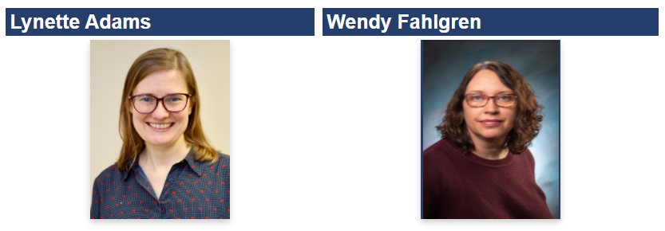
Please Contact Us
Lynette Adams, Ph.D.
Lynette.Adams@va.gov
Office of Women’s Health
Wendy Fahlgren, LISW
Wendy.Fahlgren@va.gov
Podcast Host

