Slide 1
Reimagining VHA’s Women’s Health Website
Nicole Carey & Tim Jeffreys
May 5, 2021

Slide 2


Nicole Carey
Brief Introductions
Tim Jeffreys
Background:
  Chief Strategy Officer
  Supporting VHA Women’s Health contract team
  25+ years’ experience in strategic communication planning, social marketing, outreach, stakeholder research, strategic branding, community-based outreach, event planning, and materials development.
Background:
  Web Designer/Developer
  Supporting VHA Women’s Health contract team
  20+ years’ experience in creative services, marketing and strategic communications, with over 17 years providing solutions for government organizations

Slide 3
Goal for Today’s Discussion
VHA Women’s Health wants to reimagine and retool its website to be more effective for women Veterans, partners and providers.
We are seeking input and insight from key stakeholders like you.
The GOAL for VHA Women’s Health Website: A more engaging, useful, user-friendly site that meets and anticipates stakeholder needs.
Today’s Ask: Share your thoughts, impressions, preferences and creative ideas.

Slide 4
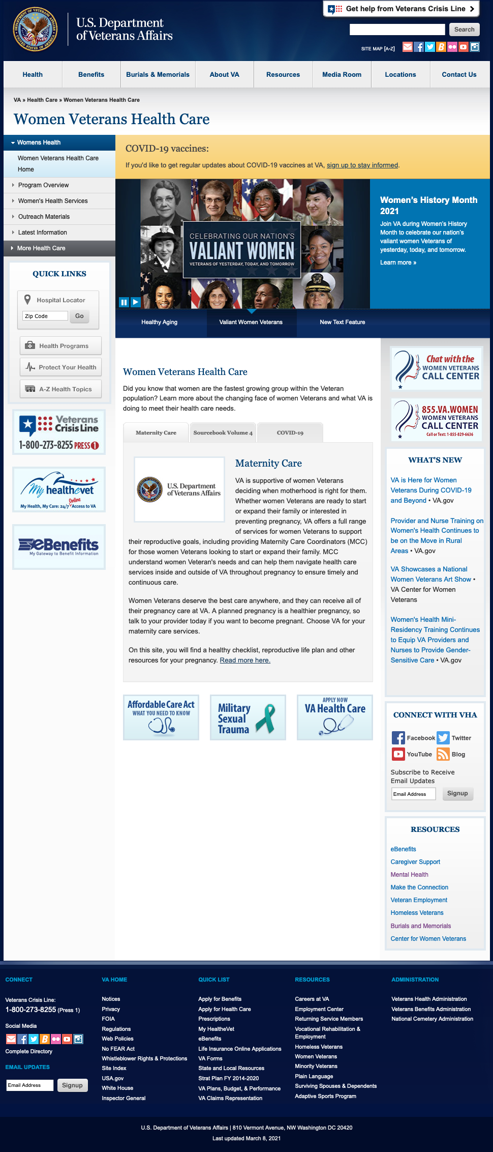
VA Website Opportunities and Limitations
A
A
B
What CANNOT change on the website:
The general frame/shell of the website (masthead/top, left column, footer)
The VA-style components
Some parts of the home page
The address/URL
https://www.womenshealth.va.gov
A

Slide 5
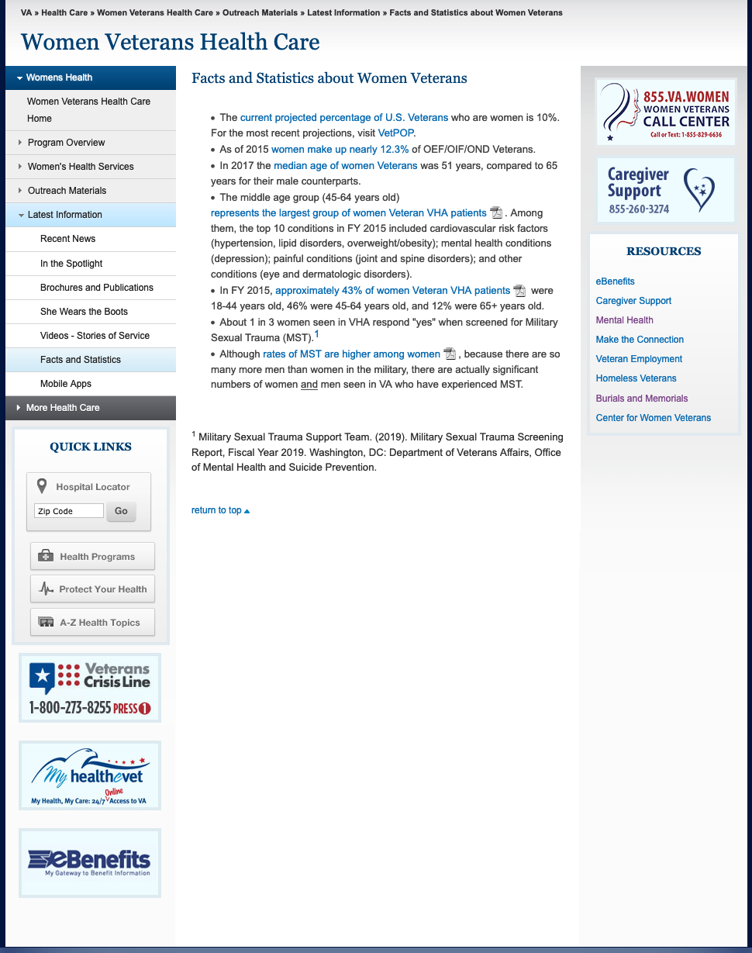
VA Website Opportunities and Limitations
What CAN change on the website:
Anything in the body of the page
Use of the right column or not, as well as items within the right column
Left column navigation buttons (order, name, nesting, etc.)
C
A
B

Slide 6
Key Questions
Have you ever seen or visited the Women’s Health website?
  If so, what do you think of it?
  If so, what information were you looking for?
Have you ever downloaded or used content/materials from the website? (if yes, what?)
What types of content or information would be most useful for women Veterans?
What types of content do you think would drive women to visit the website?
What would keep you (as a VSO partner) coming back to the website?

Slide 7
Key Questions - Continued
What type of feature or content could make this your go-to place on the web for women’s health resources?
Are there any women’s health websites with great information (or that are easy to use) that you like best?
If you could do one thing to improve the look, feel, and usability of this site, what would it be?

Slide 8
Website Screenshots: Home Page

Slide 9
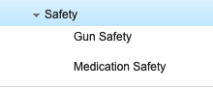
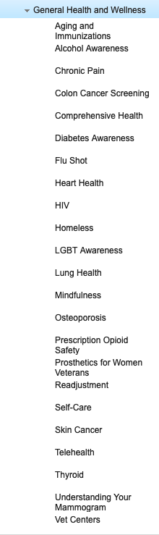
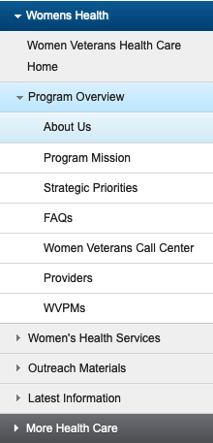
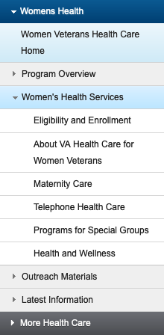
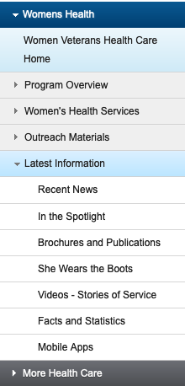
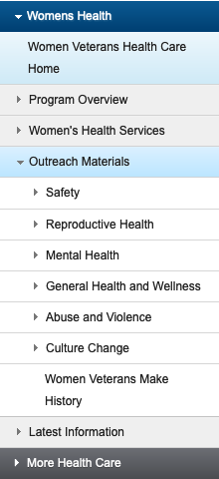
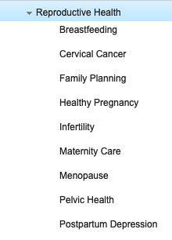
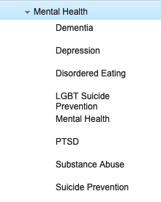
Current Website Offerings

Slide 10
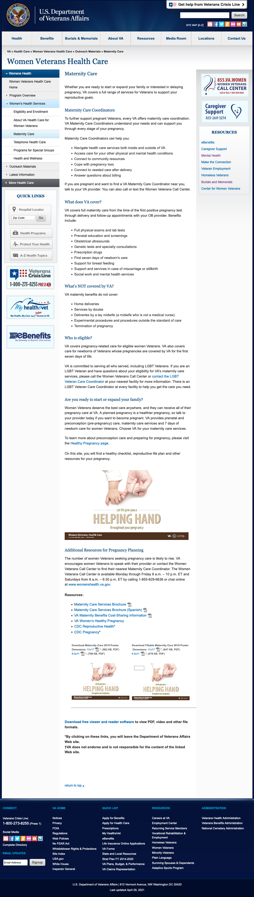
Website Screenshots: Outreach Materials (sample)

Slide 11
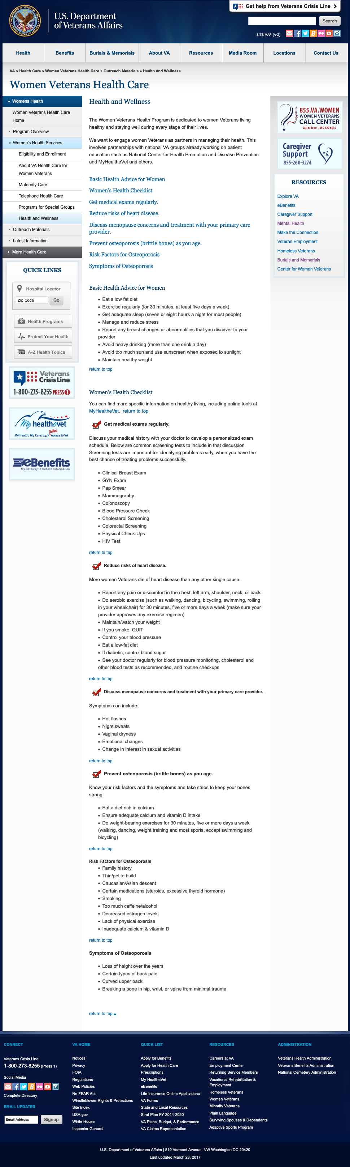
Website Screenshots: Health and Wellness

Slide 12
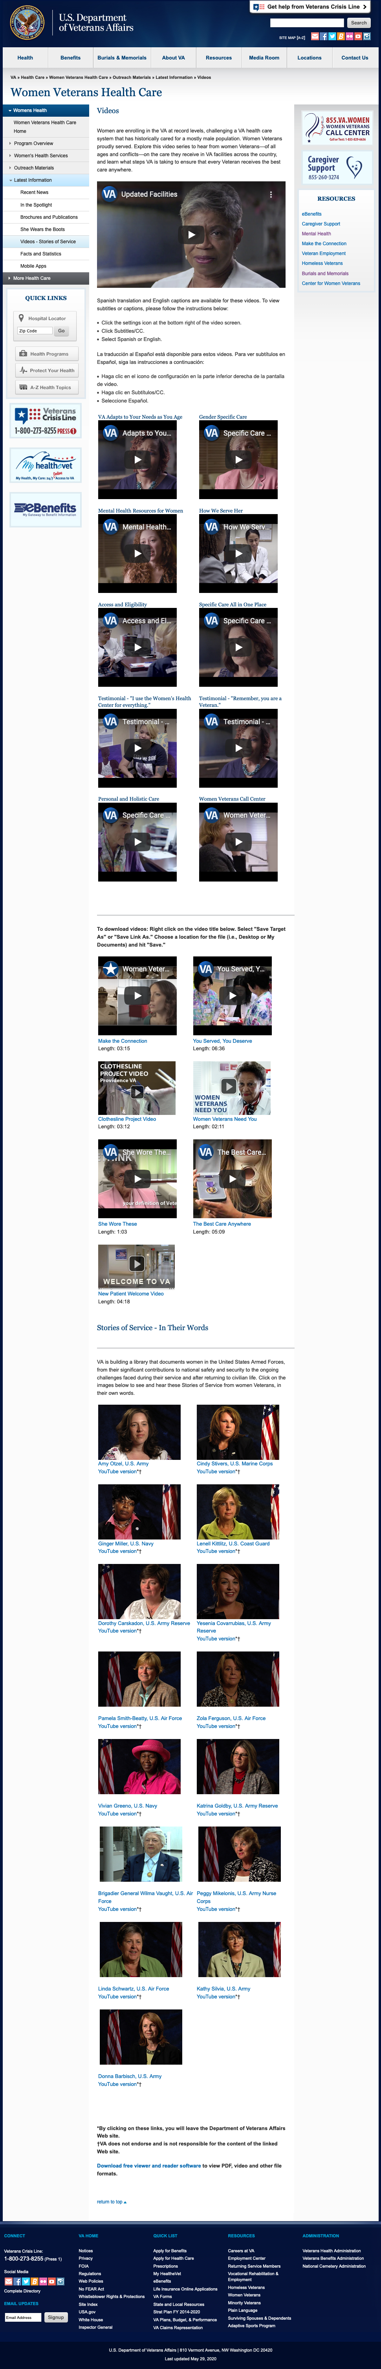
Website Screenshots: Videos

Slide 13
Key Site Specific Questions
What is your first impression of the site?
Are there specific items or content that grab your attention?
Do you think the current layout is easy to navigate and presents information clearly?
Do you think the side navigation pane and drop-down menus are user-friendly?
What would you likely do after seeing this website?
What would you change about this site if you could?
How do you prefer information to be presented online?
  How about on this website – should content be broken out by Veteran, Partner, Provider?

Slide 14
Key Site Specific Questions - Continued
What types of media do you prefer?
  Videos, interactive features that you can learn from? Articles? Links to podcasts?
Are additional resources/links important to you?
  If so, how would you like to see them organized? (e.g. by topic? by provider/partner?)
What features do you think women Veterans will use the most?
Anything else we should know about or consider when making website updates?

Slide 15
Thank you
THANK YOU!!!
If you have questions or would like to share additional insights,
please feel free to e-mail
nicole.carey@disconsutling.com or timothy.jeffreys@disconsulting.com

